Slide 1
Views Presentation
By David Hong

Slide 2
Introduction
Eclipse is a popular IDE used to program Java applications, so it is important to understand how to use its features effectively. Views are windows that help programmers organize their working space, so it can make the programming process exponentially easier.

Slide 3
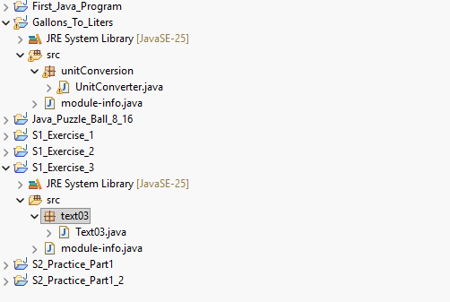
Package Explorer View
The Package Explorer is present shown on the left margin of the IDE. It contains all projects you’ve created on Eclipse, listing all classes, packages, and libraries. This view is convenient because in projects with multiple packages and classes, it would save an immense amount of time if you had access to all the project information.

Slide 4
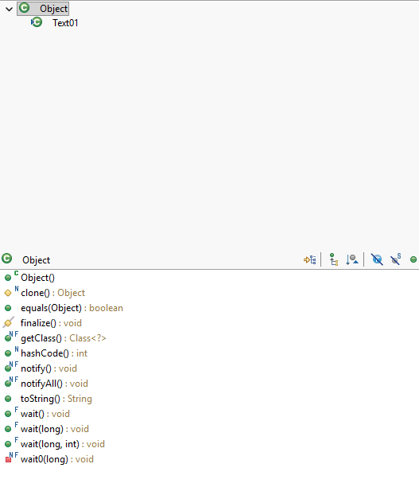
Type Hierarchy View
The Type Hierarchy View displays the different datatypes of methods in different classes, as well as the datatypes of an object’s properties/attributes. Since datatypes matter in Java, this can help determine whether or method or object is categorized as the correct datatype.

Slide 5
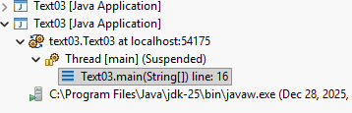

Debug View
The Debugging View helps programmers verify that the program is error free by simply “stepping inside” each step that processes the logic. This means that the program confirms each line abides by Java syntax rules, so it reduces the time to detect errors. When the debugging process is successful, it should show a screen that says it terminated.

Slide 6
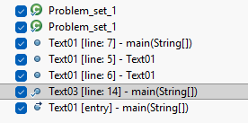

Breakpoint View
Breakpoints are used to notify the compiler where you want your program to start reading during the debugging stage. The Breakpoint view can display all breakpoints you’ve made in all your projects. This can be convenient when debugging code with thousands of lines. (The breakpoint is the blue dot)

Slide 7
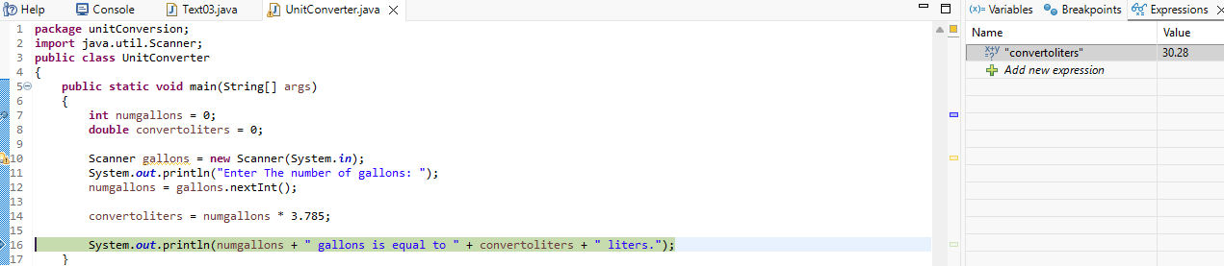
Expression View
The Expression View automatically displays the value of a variable or array index. This is especially useful when you need to perform mathematical operations, so the variable receives the correct value. While debugging, you can type a variable name, and it would provide the value it contains.

Slide 8
Summary
Overall, Eclipse has many views that can help navigate through the IDE features by providing efficient ways to organize classes and debug programs. By analyzing each datatype, line, and variable value, programmers have a less difficult time searching through for logical errors in the program.

